Slide 1

DATA SCIENCE CONSULTING Session 4
February 5th, 2019

Slide 2


Presentation of the achievements so far
Restitution of work by group
15’

Slide 3

Today’s agenda
From Natural Language Processing (NLP) to
Natural Language Understanding (NLU)

Slide 4

Agenda
1. What is topic extraction?
2. Various text representations
3. Latent Semantic Analysis (LSA)
4. Non negative Matrix Factorization (NMF)
5. Latent Dirichlet Allocation (LDA)
6. Word2vec
7. Steering Committee
8. Conclusion
9. To go further: graph of word

Slide 5
Agenda
1. What is topic extraction?
2. Various text representations
3. Latent Semantic Analysis (LSA)
4. Non negative Matrix Factorization (NMF)
5. Latent Dirichlet Allocation (LDA)
6. Word2vec
7. Steering Committee
8. Conclusion
9. To go further: graph of word

Slide 6
What is topic extraction?
Topic extraction (also called topic modeling) is a branch of unsupervised NLU which is used to represent a document with the help of several topics that can best explain the underlying information in the document.
We have a collection of words that we want to group together in such a way that each group represents a topic in a document.
Topic extraction focuses on finding the hidden thematic structures in the text, as it is believed that every text that we write is composed of themes like sports, physics, aerospace etc.
Document
Topic 1
Topic 2
Topic 3
Notes:
Talk about sparse matrix

Slide 7
Dimensionality reduction
Topic extraction usually starts with dimensionality reduction. This process reduces the number of random variables under consideration by obtaining a set of principal variables.
The obtained features are a combination of the original ones.
It consists of finding a lower-dimensional representation of a dataset such that as much information as possible about the original data is preserved.

Slide 8
Why do we perform dimensionality reduction ?
Reducing the dimension of the data representation space allows solving many issues related to high dimensionality:
Avoid the effects of curse of dimensionality
Reduce the time and storage space required (cf. sparse matrices)
Remove multi-collinearity to improve the performance of the machine learning model
Visualize easily the data when reduced to very low dimensions such as 2D or 3D
Notes:
Curse of dimensionality = fléau de la dimension. Richard Bellman in 1961. Example of 10 point on a 1-dimensional space. 100 in dim 2. In a 10 dimensional space 10^10 points are needed. That’s just impossible. The volume of the space increases so fast that the available data become sparse.

Slide 9
Agenda
1. What is topic extraction?
2. Various text representations
3. Latent Semantic Analysis (LSA)
4. Non negative Matrix Factorization (NMF)
5. Latent Dirichlet Allocation (LDA)
6. Word2vec
7. Steering Committee
8. Conclusion
9. To go further: graph of word

Slide 10
Various Text Representations
Usual techniques
Latent Semantic Analysis (LSA)
Non-negative Matrix Factorization (NMF)
Latent Dirichlet Allocation (LDA)
Hierarchical Dirichlet Processes (number of topics are not needed)
Advanced techniques
Graph of words
Word dense embeddings (Word2vec, FastText, Glove)

Slide 11
Various Text Representations
Usual techniques
Latent Semantic Analysis (LSA)
Non-negative Matrix Factorization (NMF)
Latent Dirichlet Allocation (LDA)
Hierarchical Dirichlet Processes (number of topics are not needed)
Advanced techniques
Graph of words
Word dense embeddings (Word2vec, FastText, Glove)

Slide 12
Agenda
1. What is topic extraction?
2. Various text representations
3. Latent Semantic Analysis (LSA)
4. Non negative Matrix Factorization (NMF)
5. Latent Dirichlet Allocation (LDA)
6. Word2vec
7. Steering Committee
8. Conclusion
9. To go further: graph of word

Slide 13
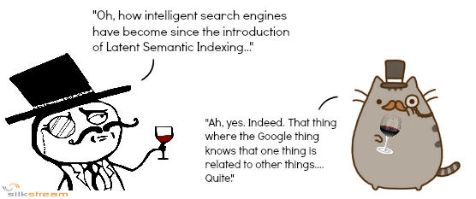
Latent Semantic Analysis (1/5)
Latent Semantic Analysis or Indexing (LSA or LSI) is a technique for creating a vector representation of a document. Having a vector representation of a document gives you a way to compare documents for their similarity by calculating the distance between the vectors.
Two main steps:
Term-Document matrix (A), using for example TF-IDF.
Singular Value Decomposition (SVD) of A. It allows a dimensionality reduction on the sparse vectors generated. It is used to get rid of redundant data.
To understand how LSA works, substantial knowledge of linear algebra and matrix computations is required in general, and of singular value decomposition (SVD) in particular

Slide 14
Latent Semantic Analysis (2/5)
Let’s start with A, the TF-IDF matrix of our corpus
Documents
A
The matrix AA^{T} contains all the correlations between terms over the set of documents
The matrix A^{T}A contains all the correlations between documents over the terms
Terms

Slide 15
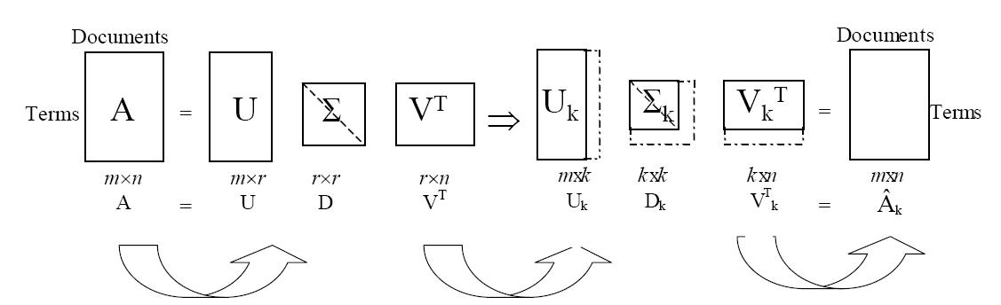
Latent Semantic Analysis (3/5)
We perform a SVD
U and V are orthogonal matrices
Σ is a diagonal matrix
The matrix Â_{k} is obtained by keeping the first k columns of U and V, and the k largest elements of Σ
Intuitively, the k remaining ingredients of the eigenvectors in U and V correspond to k “hidden concepts” where the terms and documents participate. The terms and documents have now a new representation in terms of these hidden concepts

Slide 16
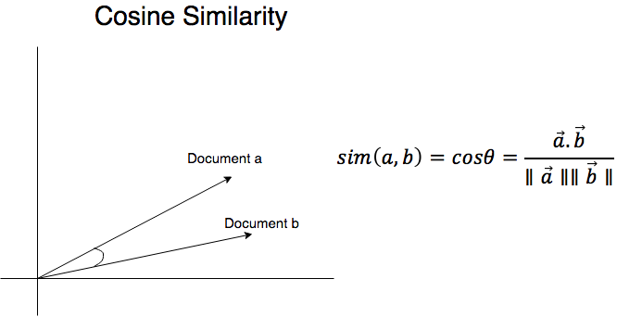
Latent Semantic Analysis (4/5)
Two different comparisons that can be done in a reduced rank vector space:
Comparing two types We have Â_{k}Â_{k}^{T} =(U_{k}Σ_{k})(U_{k}Σ_{k})^{T} → So we can see how terms i and j are related by comparing rows i and j of U_{k}Σ_{k}
Comparing two documents We have Â_{k}^{T}Â_{k} =(V_{k}Σ_{k})(V_{k}Σ_{k})^{T} → So we can see how documents i and j are related by comparing rows i and j of V_{k}Σ_{k}
In addition document and term vector representations can be clustered using traditional clustering algorithms like k-means using similarity measures like cosine.
Vectors comparison can be
performed using, for example, cosine similarity.
Notes:
Do the Math: AAT & ATA live

Slide 17

Latent Semantic Analysis (5/5)
Remarks
The amount of dimensionality reduction, i.e. the choice of k is critical and an open issue in the factor analytic literature. Ideally, k should be large enough to fit the real structure in the data, but small enough such that noise, sampling errors or unimportant details are not modeled
If a new query (= term or document) comes, you must first translate it into the low-dimensional space before you compare it with the document vectors
Weakness
The latent topic dimension k can not be chosen to arbitrary numbers. It depends on the rank of the matrix A, so can't go beyond that
Dimensions of the low-dimensional space do not correspond to comprehensible concepts
Notes:
To transform the query in the new space: query=qt * Uk * Sigma_k^(−1)

Slide 18
Agenda
1. What is topic extraction?
2. Various text representations
3. Latent Semantic Analysis (LSA)
4. Non negative Matrix Factorization (NMF)
5. Latent Dirichlet Allocation (LDA)
6. Word2vec
7. Steering Committee
8. Conclusion
9. To go further: graph of word

Slide 19
What is Non-negative Matrix Factorization ? (1/2)
Idea: use low-rank approximation with non-negative factors to improve LSI
NMF is a group of algorithms in linear algebra
Term-document matrix is factored into a term-feature and a feature-document matrix
NMF generates factors with significantly reduced dimensions compared to the original matrix
A column in WH = linear combination of the k column vectors in the features matrix W with coefficients supplied by the coefficients matrix H. This is the basis of NMF because we can consider each original as being built from a small set of hidden features. NMF generates these features.
DOCUMENTS
TOPICS
DOCUMENTS
X
W
H
TOPICS
≈
TERMS
TERMS
Non-neg
Non-neg

Slide 20
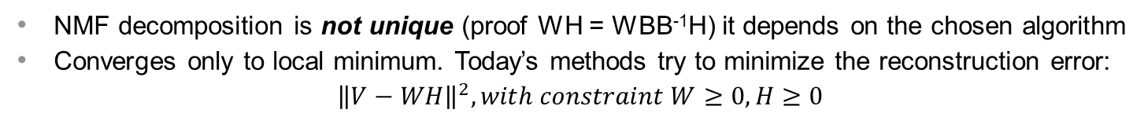
What is Non-negative Matrix Factorization ? (2/2)
Properties of NMF
W and H are not orthogonal matrices
W and H matrices can be sparse and are non-negative
Strengths
Concepts defined by the dimensions of the low-dimensional can be interpreted (combination of terms with positive weights)
Possibly faster computation time than SVD
Weaknesses
NMF decomposition is not unique (proof WH = WBB⁻¹H) it depends on the chosen algorithm
Converges only to local minimum. Today’s methods try to minimize the reconstruction error:
$${\left\|V−WH\right\|}^{2}, with constraint W≥0, H≥0$$

Slide 21
Agenda
1. What is topic extraction?
2. Various text representations
3. Latent Semantic Analysis (LSA)
4. Non negative Matrix Factorization (NMF)
5. Latent Dirichlet Allocation (LDA)
6. Word2vec
7. Steering Committee
8. Conclusion
9. To go further: graph of word

Slide 22
Latent Dirichlet Allocation (1/6)
Latent Dirichlet Allocation
This refers to everything that we don’t know a priori and is hidden in the data. Here, the topics of the reviews are unknown.
It is a “distribution of distributions”. Here, in the context of topic modeling, the Dirichlet is the distribution of topics in documents and distribution of words in the topic.
Once we have Dirichlet, we will allocate topics to the documents and words of the document to topics.

Slide 23
Latent Dirichlet Allocation (2/6)
Each document can be described by a distribution of topics and each topic can be described by a distribution of words
We introduce
latent variables
Documents
Documents
Words
topics
Words

Slide 24
Latent Dirichlet Allocation (3/6)
Automatic topic extraction
Text samples
"people", "teenagers", "family"
Document 1
Document 2
"Netflix", "TV shows", "season"
[...] People spend more time on Netflix than on [...]
[...] Black Mirror is NOT a show for the family [...]
"learn", "teaches", "English"
Topic interpretation
Topic allocation
Persons
Document 3
Document 4
TV shows
[...] Teenagers watching TV shows learn better English [...]
[...] House of cards teaches the fundamentals of the mechanics of power [...]
Document 1
Document 2
Knowledge
70%
20%
10%
50%
50%
Document 3
Document 4
75%
25%
15%
15%
70%
Tasks performed by a LDA model
Note: LDA is a generative model, which means it can create new documents, since it is purely a mathematical simulation. What’s interesting is how the algorithm work to fit the model: it finds parameters, then estimate the likelihood that the documents are simulated by the model. It then adjust the parameters, and iterate over and over and again until convergence.
Notes:
LDA does just that. It allocates words to topics, and topics to documents

Slide 25
Latent Dirichlet Allocation (4/6)
Inputs of the model:
Term Document Matrix
3 main parameters of the model
num_topics: the number of topics
Eta (“beta” in distrib.): controls the distribution of words across a topic. The lower eta, the fewer words per topic
Alpha: controls the distribution of topics across documents. The lower alpha, the fewer topics per document
Outputs of the model:
Topics
Topic 1: 0.17 * ”people” + 0.05 * ”teenagers” + 0.02 * ”family”
Topic 2: 0.54 * “Netflix” + 0.07 * “TV shows” + 0.05 * “season”
Topic 3: 0.36 * “learn” + 0.07 * “teaches” + 0.01 * “English”
Assessing results
Are your topics interpretable?
Are your topics unique? (two different topics have different words)
Are your topics exhaustive? (are all your documents well represented by these topics?)
Notes:
Remarks :
Sum of weights equal to 1, and weight are in decreasing order.
Preprocessing is important. If mainstream terms, it will biased the weights.

Slide 26
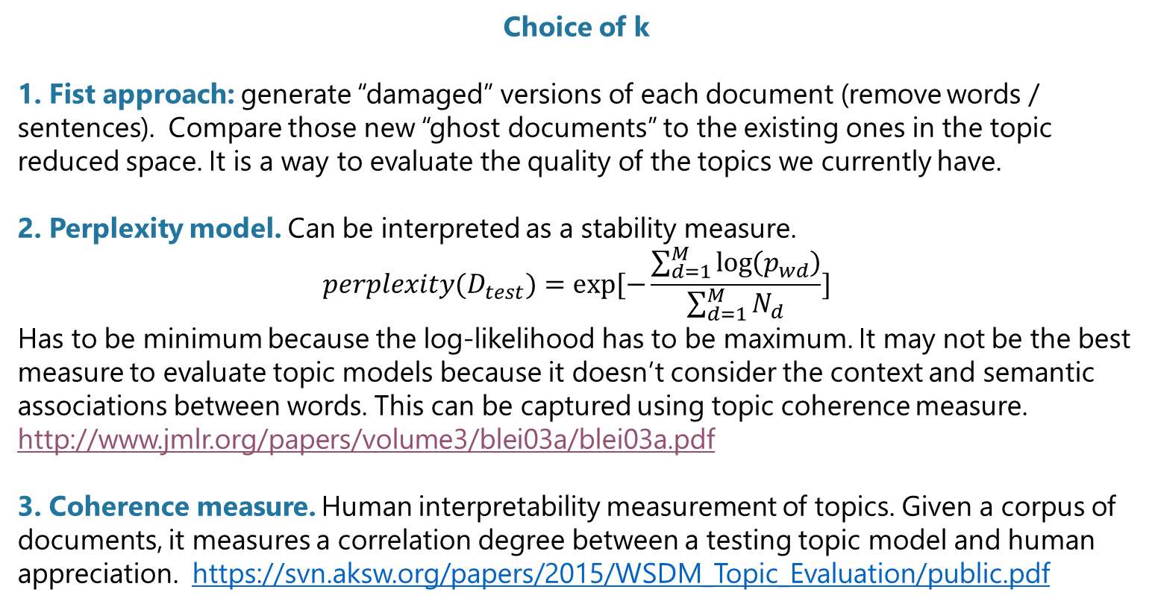
Latent Dirichlet Allocation (5/6)
Choice of k
1. Fist approach: generate “damaged” versions of each document (remove words / sentences). Compare those new “ghost documents” to the existing ones in the topic reduced space. It is a way to evaluate the quality of the topics we currently have.
2. Perplexity model. Can be interpreted as a stability measure.
$$perplexity(D_{test})=exp[−\frac{\sum_{d=1}^{M}{\log\left(p_{wd}\right)}}{\sum_{d=1}^{M}{N_{d}}}]$$
Has to be minimum because the log-likelihood has to be maximum. It may not be the best measure to evaluate topic models because it doesn’t consider the context and semantic associations between words. This can be captured using topic coherence measure.
http://www.jmlr.org/papers/volume3/blei03a/blei03a.pdf
3. Coherence measure. Human interpretability measurement of topics. Given a corpus of documents, it measures a correlation degree between a testing topic model and human appreciation. https://svn.aksw.org/papers/2015/WSDM_Topic_Evaluation/public.pdf

Slide 27
Latent Dirichlet Allocation (6/6)
LDA is good for
Creating and explaining topics. Understanding the overall content of the documents
Allocating topics to documents: understanding documents’ distribution and unicity
Allocating learned topics to new documents
LDA requires human intervention to
Interpret topics
Adjust parameters to fine-tune topics
LDA has underlying weaknesses
Topics are unstable (like k-Means). You can set the random state though
LDA is not good for
Monitoring new topics
Adding new documents to the model
Depending on your use-case (topic extraction, dimension reduction, recommendation engine...), you will have different expectations of what a good LDA model is for your dataset.
Example: a recommendation system that recommends articles with same topics does not need topic interpretability.
A good way to start with LDA is downloading Wikipedia and extracting topics. Once a good number of topics is selected, the model should predict accurately the topics of any given document.
More content
What are the proper ways to prepare a dataset before running a LDA: https://www.youtube.com/watch?v=3mHy4OSyRf0
The Maths of LDA: https://www.youtube.com/watch?v=nfBNOWv1pgE
Running a LDA on Wikipedia with gensim:
https://radimrehurek.com/gensim/wiki.html
Official research paper on LDA: http://www.jmlr.org/papers/volume3/blei03a/blei03a.pdf

Slide 28

Hands-on 1: LDA
45’
Explore the 1st notebook and perform a LDA with your data, and then with provided data
How many topics to choose?
Observe the roles of alpha and eta?
What is the good shape of a dataset (#words, #documents, ratio words/document) to find relevant topics?
Notes:
Assuming symmetric Dirichlet distributions (for simplicity), a low alpha value places more weight on having each document composed of only a few dominant topics (whereas a high value will return many more relatively dominant topics). Similarly, a low beta value places more weight on having each topic composed of only a few dominant words.

Slide 29
Agenda
1. What is topic extraction?
2. Various text representations
3. Latent Semantic Analysis (LSA)
4. Non negative Matrix Factorization (NMF)
5. Latent Dirichlet Allocation (LDA)
6. Word2vec
7. Steering Committee
8. Conclusion
9. To go further: graph of word

Slide 30
Word2vec (1/3)
word2vec is a complex model made to grasp other relevant information. word2vec defines « context » where words co-occur.
The main idea, called distributional hypothesis, is that similar words appear in similar contexts of words around them.
Created by a team of researchers at Google. These models are useful for automatic summarization, named entity recognition, sentiment analysis, question answering, machine translation, speech recognition...
Word2vec research paper
Word2vec demo
https://arxiv.org/pdf/1310.4546.pdf
http://bionlp-www.utu.fi/wv_demo/
http://turbomaze.github.io/word2vecjson/

Slide 31
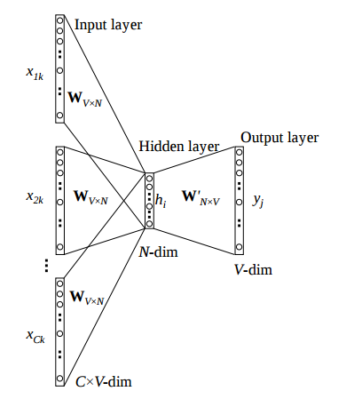
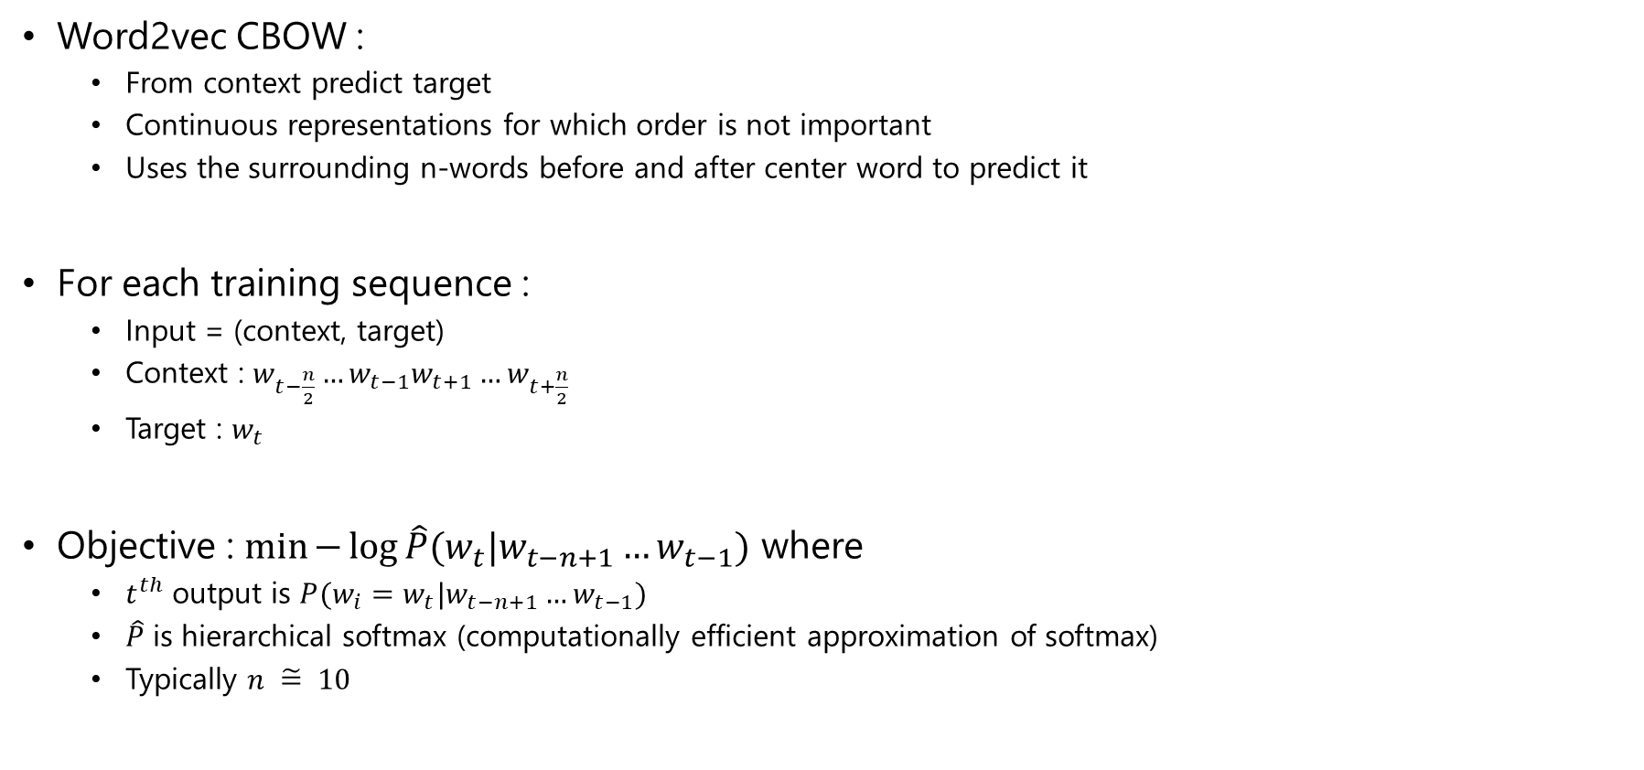
Word2vec (2/3)
Word2vec CBOW :
From context predict target
Continuous representations for which order is not important
Uses the surrounding n-words before and after center word to predict it
For each training sequence :
Input = (context, target)
Context : $w_{t−\frac{n}{2}}…w_{t−1}w_{t+1}…w_{t+\frac{n}{2}}$
Target : $w_{t}$
Objective : $\min{−\log{\hat{P}(w_{t}|w_{t−n+1}…w_{t−1})}}$ where
$t^{th}$ output is $P(w_{i}=w_{t}|w_{t−n+1}…w_{t−1})$
$\hat{P}$ is hierarchical softmax (computationally efficient approximation of softmax)
Typically $n \tilde{=} 10$

Slide 32
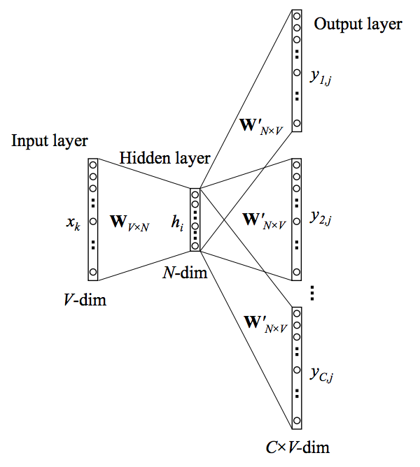
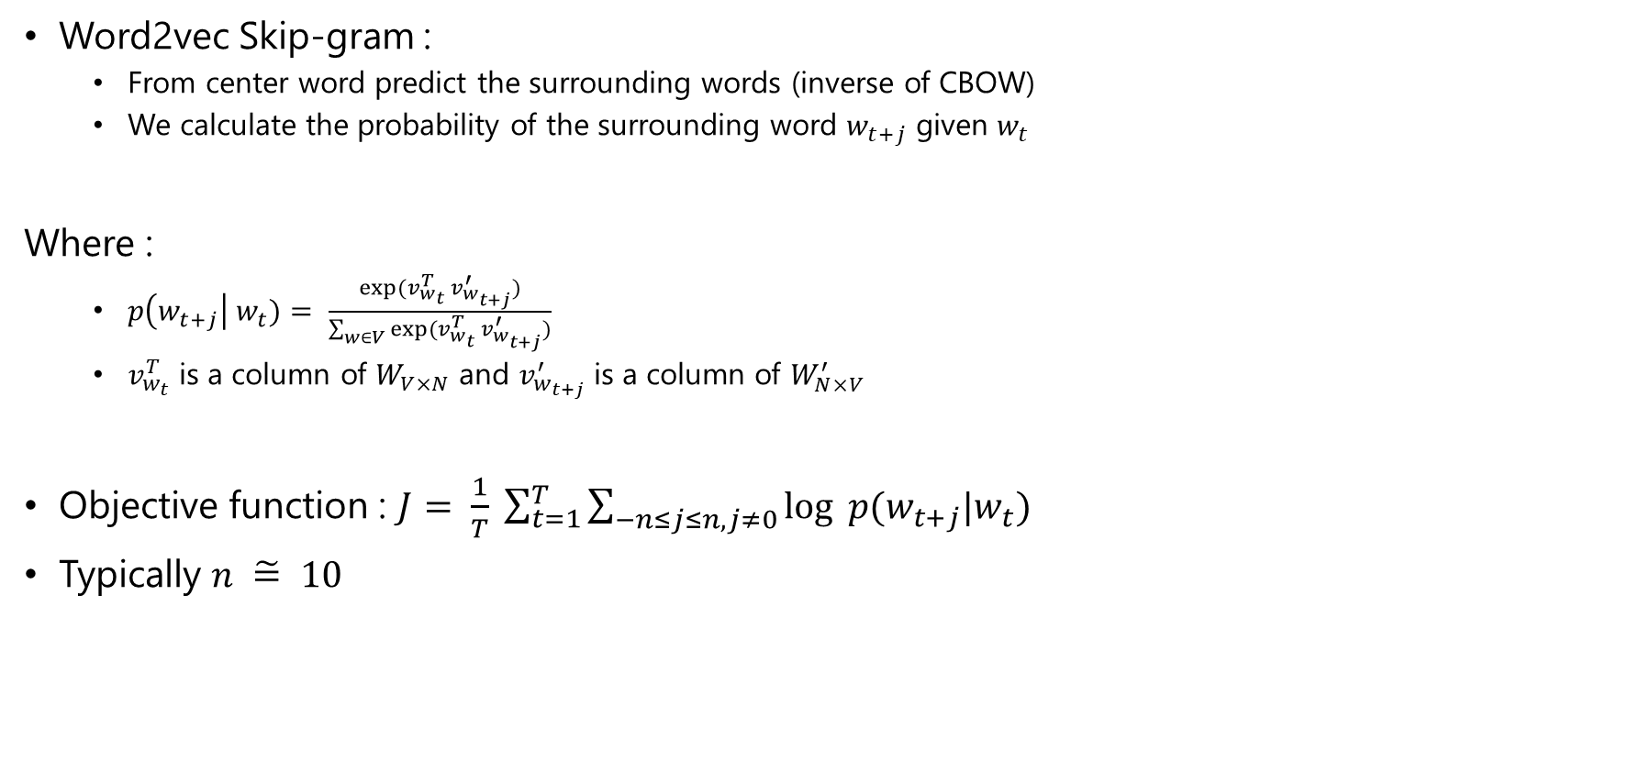
Word2vec (3/3)
Word2vec Skip-gram :
From center word predict the surrounding words (inverse of CBOW)
We calculate the probability of the surrounding word $w_{t+j}$ given $w_{t}$
Where :
$p\left(w_{t+j}\right| w_{t})= \frac{exp⁡(v_{w_{t}}^{T} v_{w_{t+j}}^{′})}{\sum_{w∈V}{exp⁡(v_{w_{t}}^{T} v_{w_{t+j}}^{′})}}$
$v_{w_{t}}^{T}$ is a column of $W_{V×N}$ and $v_{w_{t+j}}^{′}$ is a column of $W_{N×V}^{′}$
Objective function : $J= \frac{1}{T} \sum_{t=1}^{T}{\sum_{−n≤j≤n, j≠0}{log ⁡p(w_{t+j}|w_{t})}}$
Typically $n \tilde{=} 10$

Slide 33
Hands-on 2: Word2vec
45’
Explore the 2nd notebook

Slide 34
Agenda
1. What is topic extraction?
2. Various text representations
3. Latent Semantic Analysis (LSA)
4. Non negative Matrix Factorization (NMF)
5. Latent Dirichlet Allocation (LDA)
6. Word2vec
7. Steering Committee
8. Conclusion
9. To go further: graph of word

Slide 35

Hands-on: Value & KPIs and benefits & costs matrix
10’
Identify the value generated by this use case (for aftersales) and associated KPIs
Fill-in the benefits & costs matrix for this use case

Slide 36



Identified value and KPIs
Xxx
Xxx Xxx
Xxx Xxx
Xxx
Xxx Xxx
Xxx Xxx
Xxx
Xxx Xxx
Xxx Xxx

Slide 37
Example: Benefits & cost matrix
Not directly quantifiable
Directly quantifiable
Benefits
XXX | XXX
XXX | XXX
Costs

Slide 38
Report-out: Business decision
One speaker from one of the 4 groups Other groups to complete
5’

Slide 39




Planning & key steps of the course
9 weeks
08/01
15/01
29/01
05/02
12/02
19/02
05/03
12/03
19/03
Session 1
Kick-off
Session 2
Session 3
Session 4
Session 5 Steer Co
Session 6
Session 7 Restitution prep.
Session 8 Restitution prep.
Session 9 Final presentation
Caption
Regular sessions: Synthetic status update on the progress made and foreseen objectives to be prepared
Steering Committees: Complete pres. of the progress made, results; difficulties and foreseen next steps to be prepared

Slide 40
Governance bodies
Governance body
Duration & frequency
Content
Sponsors meeting
1 hour
Once a month
Review of overall project results
Validations of :
Strategic orientations
Cross-segment arbitrations and structuring decisions
Steering committee
1 hour
Once a month
Review of overall project results (advancements, added value, costs…)
Breaking points and alerts
Decision making or submission of arbitrations to the Sponsors
Project committee
1 hour
Once a week
Operational alignment on achievements and on-going actions
Identifications of attention points
Core Team stand-up
15 minutes
Each day
Sharing of what has been done the day before and what is foreseen this day
Solving of simple problems

Slide 41



Next week: Steering Committee session
Participants
Objectives
Format
Project leaders
Project Sponsor
Project Manager
Other client key stakeholders
Business unit leaders
Leaders from associated support function (IT & Big Data, Strategy, Legal etc.)
Review overall project results
Overall status
Results
Foreseen next steps
Arbitrations
Decision making on key raising of key questions
If necessary, escalation to Sponsors, for them to decide
On a regular basis, all along the project progress
At most once a month
Short and efficient – focused on results & key questions
Duration ~1 hour

Slide 42
Agenda
1. What is topic extraction?
2. Various text representations
3. Latent Semantic Analysis (LSA)
4. Non negative Matrix Factorization (NMF)
5. Latent Dirichlet Allocation (LDA)
6. Word2vec
7. Steering Committee
8. Conclusion
9. To go further: graph of word

Slide 43


Today we learned
Usual BoW techniques
Advanced techniques
Get ready for Steering Committee
Latent Semantic Analysis
Non-negative Matrix Factorization
Latent Dirichlet Allocation
Word2vec
Graph-of-word (bonus)
Identify KPIs
Fill a Benefits & Costs matrix
The governance bodies

Slide 44

Next week: Steering Committee session
30’
Content to be prepared:
Reminder on the context and objectives of the overall project
Project status to date (overall achievements & progress)
Specific & targeted focuses on:
Key achievements
Alerts, blocking points & key decisions
Next steps & foreseen planning
Make it understandable for business stakeholders!
per group

Slide 45
Work for February, 19th
Instructions
Extract the main topics of your comments using various methods (at least LDA and graph-of-words)
Prepare a notebook that you will present at the beginning of next session

Slide 46
THANK YOU!

Slide 47
Agenda
1. What is topic extraction?
2. Various text representations
3. Latent Semantic Analysis (LSA)
4. Non negative Matrix Factorization (NMF)
5. Latent Dirichlet Allocation (LDA)
6. Word2vec
7. Steering Committee
8. Conclusion
9. To go further: graph of word

Slide 48
Graph of words (1/3)
A state of the art method invented by M. Vazirgiannis (LIX, Ecole polytechnique!)
Challenges “term independence” and “term frequency weighting” assumptions taking into account word dependence, order and distance
Employ a graph-based document representation capturing the above
Encodes the strength of the dependence as edge weights
Captures term order via directed edges
Documents are a list of consecutive words, direct neighbors have more weight than remote neighbors in the document
To understand, follow this link to complete course: https://mklab.iti.gr/essir2015/wp-content/uploads/2015/03/ESSIR2015_Vazirgiannis.pdf

Slide 49
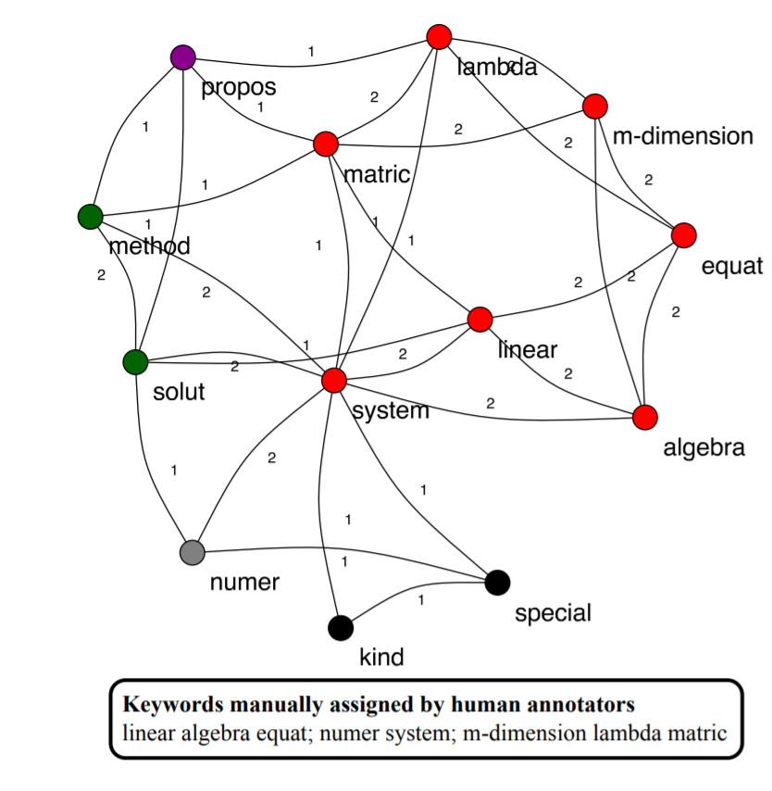
Graph of words (2/3)

Slide 50
Graph of words (3/3)
Interactive live demo
https://safetyapp.shinyapps.io/GoWvis/

